Slide 1
Objectives
In this lesson, you will learn to:
Implement the concept of inheritance in Java
Override methods
Create Interfaces
The super and this keywords
Identify the various types of exceptions in Java
Handle exceptions by using the try, catch, and finally clauses
Use the throw statement
Implement user-defined exceptions
The nested try and catch block
Try with Resource Statement
Packages in Java
User-defined packages

Slide 2
Inheritance in Java
Introduction to Inheritance
Inheritance enables a class to:
Inherit data members and methods from another class.
Reuse the functionalities and capabilities of the existing class by extending a new class from the existing class and adding new features to it.

Slide 3
Inheritance in Java (Contd.)
Introduction to Inheritance (Contd.)
The class that inherits the data members and methods from another class is known as the subclass.
The class from which the subclass inherits is known as the superclass.
The superclass is also referred to as the base class, and the subclass is referred to as the derived class.
You can create additional data members and methods to add more features in a subclass.
A superclass can also be a subclass of another class.

Slide 4
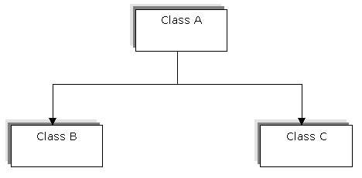
Inheritance in Java (Contd.)
Implementing Different Types of Inheritance
Single level inheritance
Derives a subclass from a single superclass. For example, subclasses B and C inherit the properties of a single superclass, A. The following figure shows the structure of single level inheritance:

Slide 5
Inheritance in Java (Contd.)
Implementing Different Types of Inheritance (Contd.)
Single level inheritance
The following syntax shows how to implement single level inheritance:
class A
{
}
class B extends A
{
}
class C extends A
{
}
In the preceding syntax, the extends keyword is used to derive a subclass from a superclass.

Slide 6
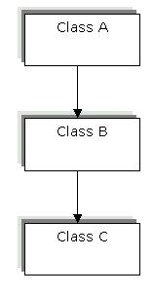
Inheritance in Java (Contd.)
Implementing Different Types of Inheritance (Contd.)
Multilevel inheritance
Inherits the properties of another subclass. For example, Class A is a superclass for the Class B; and Class B is a superclass for the subclass, Class C. You can include any number of levels in multilevel inheritance. The following figure shows the structure of multilevel inheritance:

Slide 7
Inheritance in Java (Contd.)
Implementing Different Types of Inheritance (Contd.)
Multilevel inheritance
The following syntax shows how to implement multilevel inheritance:
class A
{
}
class B extends A
{
}
class C extends B
{
}
In the preceding syntax, class A is the superclass and class C is the subclass. The class B acts as a subclass for the class A and superclass for the class C.

Slide 8
Implementing Method Overriding
Method overriding
Method overriding is defined as creating a method in the subclass that has the same return type and signature as a method defined in the superclass.
Signature of a method includes the name, number, sequence, and type of arguments of a method.
The created method of the subclass hides the method defined in the superclass.

Slide 9
Implementing Method Overriding
(Contd.)
Method overriding (Contd.)
Method overriding enables you to create objects that respond to the same method as defined in the superclass.
A subclass must override the abstract methods of a superclass.
You cannot override the static and final methods of a superclass.

Slide 10
Implementing Interfaces
Overview of Interface
Interfaces contain a set of abstract methods and static data members.
Interface is known as a prototype for a class.
Methods defined in an interface are only abstract methods.
An abstract method contains only the declaration for a method without any implementation details.
The implementation of an abstract method is defined in the class implementing the interface.
You can implement multiple interfaces in a single class.

Slide 11
Implementing Interfaces (Contd.)
Overview of Interface (Contd.)
The following syntax shows how to define an interface:
interface <interfacename>
{
//interface body
static final data members
return type public methods(parameters);
}
You can implement an interface in one or more than one class before defining it. The public access specifier must be specified with the methods declared in the interface.

Slide 12
Implementing Interfaces
(Contd.)
Overview of Interface (Contd.)
The following syntax shows how to implement an interface in a class:
class <class_name> extends [superclass] implements [interfacename]
{
//Defining the method declared in the interface.
return type public methods(parameters)
{
}
}
In the preceding syntax, a class that extends from a superclass implements an interface using the implements keyword.

Slide 13
Implementing Interfaces
(Contd.)
Overview of Interface (Contd.)
Interfaces also enable you to declare constants that can be imported into multiple classes.
The constant values declared in an interface can be implemented in any class.
The constants defined in an interface are declared using the final keyword.

Slide 14
Implementing Interfaces
(Contd.)
Implementing Multiple Interfaces in a class
interface Bank
{
public void bankDeposit();
}
interface FinancialInstitute
{
public void securityDeposit();
}

Slide 15
Implementing Interfaces (Contd.)
Implementing Multiple Interfaces in a class (Contd.)
class Deposit implements Bank, FinancialInstitute
{
int sd = 125;
int bd = 256;
public void bankDeposit()
{
System.out.println(" ");
System.out.println("\t The money deposited in the bank is $" + bd);
System.out.println(" ");
}

Slide 16
Implementing Interfaces (Contd.)
Implementing Multiple Interfaces in a class (Contd.)
public void securityDeposit()
{
System.out.println(" ");
System.out.println("\t The money deposited in the financial institute is $" + sd);
System.out.println(" "); }
public static void main(String args[]) {
Deposit d = new Deposit();
d.bankDeposit();
d.securityDeposit(); }
}

Slide 17
Pre-assessment Questions
1. Which type of inheritance supports repeating inheritance?
a. Single level inheritance
b. Multiple inheritance
c. Multilevel inheritance
d. Multipath inheritance
2. Which keyword is used to define the constants in an interface?
a. super
b. public
c. private
d. final

Slide 18
Pre-assessment Questions (Contd.)
3. Which concept of object-oriented programming is used in method overriding?
a. Polymorphism
b. Abstraction
c. Encapsulation
d. Inheritance
4. What is the return type of the methods declared in an interface?
a. Default
b. private
c. protected
d. public

Slide 19
Pre-assessment Questions (Contd.)
5. Which type of inheritance enables you to inherit class data members and methods from more than one superclass?
Single level inheritance
Multiple inheritance
Multilevel inheritance
Multipath inheritance

Slide 20
Solutions to Pre-assessment Questions
b. Multiple inheritance
d. final
a. Polymorphism
d. public
b. Multiple inheritance

Slide 21
The super and this Keywords
The super keyword
Java provides the super keyword that enables a subclass to refer to its superclass. The super keyword is used to access:
superclass constructors
superclass methods and variables
The syntax to invoke the constructor of a superclass using the super() method is:
super (<parameter1>, <parameter 2>,..,<parameterN>);
In the above syntax, <parameter1>, <parameter 2>,..,<parameterN> refer to the list of parameters that you need to pass to the constructor of the superclass.

Slide 22
The super and this Keywords (Contd.)
The super Keyword (Contd.)
If no parameters are passed to the super() method, it invokes the default constructor of the superclass.
If the superclass contains the overloaded constructor, you can pass parameters to the super() method to invoke a particular constructor.
When you use the super() method in the constructor of the subclass, it should be the first executable statement in the constructor.

Slide 23
The super and this Keywords (Contd.)
The super Keyword (Contd.)
The syntax to access the member variable of a superclass is:
super.<variable>;
The subclass can also access the member methods of the superclass using the super keyword.

Slide 24
The super and this Keywords (Contd.)
The this Keyword
The this keyword is used to refer to the current object.
You can use the this keyword when a method defined in a Java class needs to refer to the object used to invoke that method.
The following code snippet shows how to use the this keyword:
Book(int bcode, double bprice)
{
this.bookCode=bcode;
this.bookPrice=bprice;
}
In the above code snippet, the this keyword refers to the object that invokes the Book() constructor.

Slide 25
The super and this Keywords (Contd.)
The this Keyword (Contd.)
Another situation where you can use the this keyword is when the local and instance variables have the same name.
The following code snippet shows how to use the this keyword when instance and formal parameters have the same name:
Book(int bcode, double bprice)
{
this.bcode=bcode;
this.bprice=bprice;
}
In the above code snippet, this keyword refers to the instance variables, bcode and bprice. The values of the formal parameters, bcode and bprice of the Book() constructor are assigned to the instance variables.

Slide 26
The super and this Keywords (Contd.)
The this Keyword (Contd.)
In addition, you can use the this keyword in a constructor of a class to invoke another constructor of the class.
Unlike the super keyword, the this keyword can invoke the constructor of the same class.
The following code snippet shows how to invoke a constructor using the this keyword:
class Book {
public Book(String bname) {
this(bname, 1001); }
public Book(String bname, int bcode) {
bookName=bname;
bookCode=bcode; }
}

Slide 27
Exceptions in Java
An exception can be defined as an abnormal event that occurs during program execution and disrupts the normal flow of instructions.
Errors in a Java program are categorized into two groups:
Compile-time errors
Run Time errors
Concept of Exceptions:
The unexpected situations that occur during program execution are:
Running out of memory
Resource allocation errors
Inability to find files
Problems in network connectivity

Slide 28
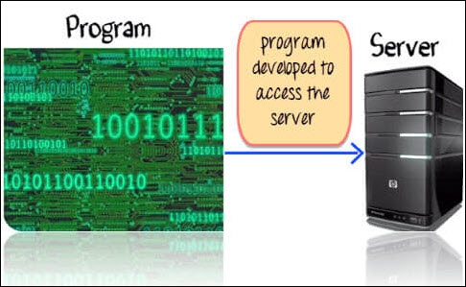
Why do we need Exception? Suppose you have coded a program to access the server. Things worked fine while you were developing the code.

Slide 29

During the actual production run, the server is down. When your program tried to access it, an exception is raised.

Slide 30
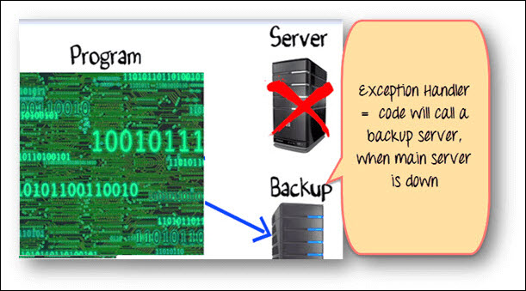
How to Handle Exception? Exception is beyond developer's control. But blaming your code failure on environmental issues is not a solution. You need a Robust Programming, which takes care of exceptional situations. Such code is known as Exception Handler. In our case exception handling would be, when the server is down, connect to the backup server.
class connect{
if(Server Up){
// code to connect to server }
else{
// code to connect to BACKUP server
} }

Slide 31
Exceptions in Java (Contd.)
Exception Classes
The following figure shows the Exception class heirarchy:

Slide 32
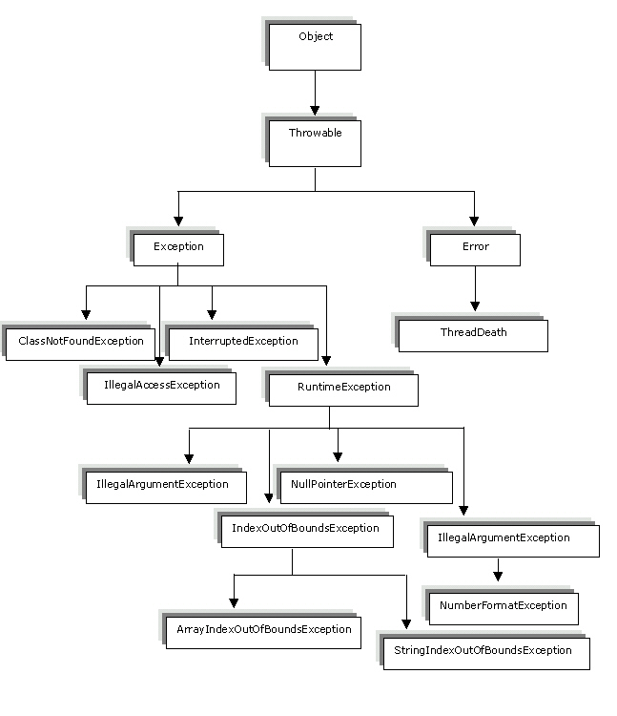
Exceptions in Java (Contd.)

Slide 33
Exceptions in Java (Contd.)
Built-in Exceptions
Java consists of the following categories of built-in exceptions:
Checked Exceptions
Unchecked Exceptions
Checked exceptions are checked at compile-time. Example- ClassNotFoundException, IOException, SQLException and so on.
Unchecked exceptions are not checked at compile-time, but they are checked at runtime. Example of unchecked exceptions are : ArithmeticException, ArrayStoreException, ClassCastException and so on.

Slide 34
Exceptions in Java (Contd.)
The following table lists the various checked exceptions in Java:
Exception
Cause of Creation
ClassNotFoundException
Occurs when the Java run time system is unable to find the class referred.
IllegalAccessException
Occurs when you want to refer a class that is not accessible.
InstantiationException
Occurs when you try to create an object of an abstract class or interface.
NoSuchMethodException
Occurs when you call a method that does not exist.

Slide 35
Exceptions in Java (Contd.)
The following table lists the various unchecked exceptions:
Exception
Cause of Creation
ArithmeticException
Occurs when you make an arithmetic error, such as dividing a number by zero.
ArrayIndexOutOfBoundsException
Occurs when an attempt is made to access an array element beyond the index of the array.
ArrayStoreException
Occurs when you assign an element to an array that is not compatible with the data type of that array.

Slide 36
Example of Checked Exceptions: public static void main(String[] args) { FileReader file = new FileReader("somefile.txt"); } In above case, you will get compile time error with message – Unhandled exception type FileNotFoundException.

Slide 37
Example of Unchecked Exceptions: class Main { public static void main(String args[]) { int x = 0; int y = 10; int z = y/x; System.out.println(z); } } Exception in thread "main" java.lang.ArithmeticException: / by zero at Main.main(Main.java:5)

Slide 38
Implementing Exception Handling
You can implement exception-handling in a program by using the following keywords:
try
catch
throw
throws
finally
Using try and catch statements
The try block encloses the statements that might raise an exception within it and defines the scope of the exception handlers associated with it.
The catch block is used as an exception-handler. You enclose the code that you want to monitor inside a try block to handle a run time error.

Slide 39
Implementing Exception Handling (Contd.)
The following syntax shows how to declare the try-catch block:
try
{
// Statements that cause an exception.
}
catch(ExceptionName obj)
{
// Error handling code.
}
Using multiple catch statements
A single try block can have many catch blocks. This is necessary when the try block has statements that raise different types of exceptions.

Slide 40
Implementing Exception Handling (Contd.)
The multiple catch blocks generate unreachable code error.
If the first catch block contains the Exception class object then the subsequent catch blocks are never executed.
The Exception class being the superclass of all the exception classes catches various types of exceptions. The Java compiler gives an error stating that the subsequent catch blocks have not been reached.
This is known as the unreachable code problem.
To avoid unreachable code error, the last catch block in multiple catch blocks must contain the Exception class object.
Using the finally clause
The finally block is used to process certain statements, no matter whether an exception is raised or not.

Slide 41
//Example of Unreachable code: class Excep { public static void main(String[] args) { try { int arr[]={1,2}; arr[2]=3/0; } catch(Exception e) //This block handles all Exception { System.out.println("Generic exception"); } catch(ArrayIndexOutOfBoundsException e) //This block is unreachable { System.out.println("array index out of bound exception"); } }}

Slide 42
Implementing Exception Handling (Contd.)
The following syntax shows how to declare the try-finally block:
try
{
// Block of code
}
finally
{
// Block of code that is always executed irrespective of an exception being raised or not.
}

Slide 43
Throwing an Exception
Throws Vs Throw In Java
Throws is used to declare an exception, which means it works similar to the try-catch block. On the other hand throw keyword is used to throw an exception explicitly.
throw is followed by an instance of Exception class and throws is followed by exception class names. For example:
throw new ArithmeticException("Arithmetic Exception");
throws ArithmeticException;

Slide 44
Throwing an Exception
Throws Vs Throw In Java
Throw keyword is used in the method body to throw an exception, while throws is used in method signature to declare the exceptions that can occur in the statements present in the method.
For example:
... void myMethod()
{
try
{
//throwing arithmetic exception using throw
throw new ArithmeticException("Something went wrong!!");
}
catch (Exception exp)
{
System.out.println("Error: “ + exp.getMessage());
}
} ...

Slide 45
Throwing an Exception
Throws Vs Throw In Java
Throws
For example:
...
//Declaring arithmetic exception using throws
void sample() throws ArithmeticException
{
//Statements
}
...

Slide 46
Throwing an Exception
Throws Vs Throw In Java
You can throw one exception at a time but you can handle multiple exceptions by declaring them using throws keyword. Throw:
void myMethod()
{
//Throwing single exception using throw
throw new ArithmeticException("An integer should not be divided by zero!!");
} ..

Slide 47
Throwing an Exception
Throws Vs Throw In Java
You can throw one exception at a time but you can handle multiple exceptions by declaring them using throws keyword. Throws:
//Declaring multiple exceptions using throws
void myMethod() throws ArithmeticException, NullPointerException
{
//Statements where exception might occur
}

Slide 48
The Nested try-catch Block
The try-catch block is used to handle exceptions in Java applications.
You can enclose a try-catch block in an existing try-catch block.
The enclosed try-catch block is called the inner try-catch block, and the enclosing block is called the outer try-catch block.
If the inner try block does not contain the catch statement to handle an exception then the catch statement in the outer block is checked for the exception handler.
The following syntax shows how to create a nested try-catch block:
class SuperClass
{
public static void main(String a[])
{
<code>;
try
{

Slide 49
The Nested try-catch Block (Contd.)
The following syntax shows how to create a nested try-catch block: (Contd.)
<code>;
try
{
<code>;
}
catch(<exception_name> <var>)
{
<code>;
}
}
catch(<exception_name> <var>)
{
<code>;
} } }

Slide 50
The finally Block
The finally block associated with a try block is executed after the try or catch block is completed.
It is optional to associate the finally block with a try block, but if the try block does not have a corresponding catch block, you should provide the finally block.

Slide 51
Try with Resource Statement
JDK 7 introduces a new version of try statement known as try-with-resources statement. This feature add another way to exception handling with resources management. It is also referred to as automatic resource management.

Slide 52
Syntax
try(resource-specification(there can be more than one resource))
{
//use the resource
}
catch()
{... }
A resource is an object that is used in program and must be closed after the program is finished. The try-with-resources statement ensures that each resource is closed at the end of the statement of the try block. You do not have to explicitly close the resources.

Slide 53
Example without using try with Resource Statement
import java.io.*;
class Test {
public static void main(String[] args)
{
try
{
String str;
//opening file in read mode using BufferedReader stream
BufferedReader br = new BufferedReader(new FileReader("d:\\myfile.txt"));
while((str=br.readLine())!=null)
{
System.out.println(str);
}
br.close(); //closing BufferedReader stream
}
catch(IOException ie)
{
System.out.println("exception");
} } }

Slide 54
Example using try with Resource Statement
import java.io.*;
class Test {
public static void main(String[] args)
{
Try(BufferedReader br = new BufferedReader(new FileReader("d:\\myfile.txt"));
{
String str;
while((str=br.readLine())!=null)
{
System.out.println(str);
}
}
catch(IOException ie)
{
System.out.println("exception");
} } }

Slide 55
FAQs
Can classes inherit from more than one class in Java?
No, a class cannot be inherited from more than one class in Java. A class is inherited from a single class only. However, multi-level inheritance is possible in Java. For example, if class B extends class A and class C extends class B, class C automatically inherits the properties of class A.
What is the difference between an interface and a class?
Both, class and interface, contain constants and methods. A class not only defines methods but also provides their implementation. However, an interface only defines the methods, which are implemented by the class that implements the interface.

Slide 56
FAQs (Contd.)
Do you have to catch all types of exceptions that might be thrown by Java?
Yes, you can catch all types of exceptions that are thrown in a Java application using the Exception class.
How many exceptions can you associate with a single try block?
There is no limit regarding the number of exceptions that can be associated with a single try block. All the exceptions associated with a try block should be handled using multiple catch blocks.

Slide 57
FAQs (Contd.)
What are the disadvantages of inner classes?
The inner classes have various disadvantages. The use of inner class increases the total number of classes in your code. The Java developers also find it difficult to understand to implement the concept of inner class within the programs.
What is the level of nesting for classes in Java?
There is no limit of nesting classes in Java.

Slide 58
Packages in Java
A package is a set of classes that are stored in a directory, which has the same name as the package name.
Packages enable you to organize the class files provided by Java.
Java packages are classified into two categories:
Java API packages
Java user-defined packages

Slide 59
Using packages while coding offers a lot of advantages like: 1)Re-usability: The classes contained in the packages of another program can be easily reused 2)Name Conflicts: Packages help us to uniquely identify a class, for example, we can have company.sales.Employee and company.marketing.Employee classes 3)Controlled Access: Offers access protection such as protected classes, default classes and private class 5)Data Encapsulation: They provide a way to hide classes, preventing other programs from accessing classes that are meant for internal use only 6)Maintainance: With packages, you can organize your project better and easily locate related classes

Slide 60
Packages in Java (Contd.)
The following table lists a few built-in Java packages:
Java Package Name
Description
java.lang
Provides various classes, such as Object, System, and Class.
java.util
Provides various classes that support collection or groups of objects, such as hash tables, String parsing, and system properties.
java.io
Defines two streams, InputStream and OutputStream that determine the flow of bytes from a source to destination.

Slide 61
Packages in Java (Contd.)
The various built-in packages of Java are: (Contd.)
Java Package Name
Description
java.awt
Provides classes to implement graphical user interface, such as creating buttons, check boxes, text boxes, menus, and list boxes.
java.net
Provides classes that support network programming, such as Socket, ServerSocket, and DatagramSocket.
java.applet
Provides the Applet class that provides methods to display images, play audio files, and obtain information about the applet environment. Some of these methods are play(), getImage(), getAppletInfo(), and getAudioClip().

Slide 62
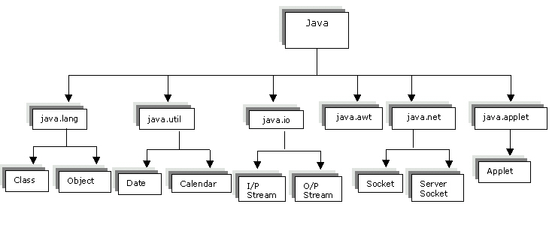
Packages in Java (Contd.)
The hierarchy of the Java API packages:

Slide 63
User–Defined Packages
When you write a Java program, you create many classes. You can organize these classes by creating your own packages.
The packages that you create are called user-defined packages.
A user-defined package contains one or more classes that can be imported in a Java program.
Creating a user-defined package
The following syntax shows how to create a user-defined package:
package <package_name>
// Class definition
public class <classname1>
{
// Body of the class.
}
public class <classname2>
{
// Body of the class.}

Slide 64
User–Defined Packages (Contd..)
To create a user-defined package, perform the following steps:
Create a source file containing the package definition
Create a folder having the same name as package name and save the source file within the folder.
Compile the source file.
Importing a user-defined package
You can include a user-defined package using the import statement.
The following syntax shows how to implement the user-defined package, empDetails from the app directory in a program:
import app.empDetails.Employee;
public class Director extends Employee
{
// Body of the class.
}

Slide 65
Exploring java.lang Package
The java.lang package provides various classes and interfaces that are fundamental to Java programming.
The java.lang package contains various classes that represent primitive data types, such as int, char, long, and double.
Classes provided by the java.lang package:
Class
Description
Object
All the classes in the java.lang package are subclasses of the Object class and inherit its methods. The toString() method creates a String representation of the value of an object of the Object class. This method is automatically called when you display an Object using the println() method.

Slide 66
Exploring java.lang Package (Contd.)
Class
Description
Class
Supports runtime processing of the class information of an object. The Class class also supports the toString() method.
System
Provides a standard interface to input, output, and error devices, such as keyboard and Visual Display Unit (VDU). The System class has the variables, in, out, and err represent input, output, and error respectively.
Wrapper
Represents the primitive data types, such as int, char, and double, as objects. In addition, the Wrapper class provides methods to convert strings to various data types.

Slide 67
Exploring java.lang Package (Contd.)
Class
Description
Integer
Provides methods for converting an int object to a String object.
Math
Provides various numeric constants and methods for statistics, logarithms, exponents, and trigonometry.
String
Supports operations on Strings and characters.

Slide 68
Exploring java.lang Package (Contd.)
The Math Class
The java.lang.Math class provides various methods for performing numeric operations, such as calculating the square root of a number, absolute value of a number, maximum and minimum values, random, and trigonometric functions such as sin(), cos(), and tan().

Slide 69
Exploring java.lang Package (Contd.)
Method
Description
Syntax
abs()
Accepts a parameter of data type, such as int, long, float, or double and returns the absolute value of that parameter.
public static double abs(double x)
public static float abs(float x)
public static int abs(int x)
ceil()
Returns the smallest double value of the next higher integer.
public static double ceil(double x)
floor()
Returns the largest double value of the next smaller integer.
public static double floor(double x)

Slide 70
Exploring java.lang Package (Contd.)
Method
Description
Syntax
max()
Accepts two arguments and returns the larger of the two values of the arguments. The two arguments should be of same data type such as float, double, int, or long.
public static float max(float x, float y)
public static double max(double x, double y)
public static int max(int x, int y)
min()
Accepts two parameters and returns the smaller of the two values of the arguments. The two parameters should be of same data type such as float, double, int, or long.
public static float min(float x, float y)
public static double min(double x, double y)
public static int min(int x, int y)

Slide 71
Exploring java.lang Package (Contd.)
Method
Description
Syntax
random()
Accepts no argument and returns a positive, double, value randomly generated, greater than or equal to 0.0 and less than 1.0.
public static double random()
round()
Accepts one parameter of the double or float data type and returns the integer value closest to the parameter.
public static long round(double x)
public static int round(float x)
sin()
Accepts an angle in radian as parameter and returns the trigonometric sine of the angle.
public static double sin(double x)

Slide 72
Exploring java.lang Package (Contd.)
Method
Description
Syntax
cos()
Accepts an angle in radian as parameter and returns the trigonometric cosine of the angle.
public static double cos(double x)
tan()
Accepts an angle in radian as parameter and returns the trigonometric tangent of the angle.
public static double tan(double x)
sqrt()
Accepts one parameter of data type double and returns the positive square root of that parameter.
public static double sqrt(double x)

Slide 73
Exploring java.lang Package (Contd.)
The String Class
Methods of the String class:
Method
Description
Syntax
length()
Returns the length of a String object.
public int length()
charAt()
Returns the character at the specified index, which ranges from 0 to the second last element.
public char charAt(int index)
getChars()
Copies characters from a source String object into the destination character array.
public void getChars(int srcBegin, int srcEnd, char[] dstn, int dstnBegin)

